Slide 1
My Story of becoming a Maker
By Antares Zhang
RDFZ SCIEXP

Slide 2
My Story------ an outline
Typical high school student at RDFZ
Introduced to 3D printing at school
Joined Open Wisdom Lab at THU
Learned Arduino at school&OWL
Little Projects with Arduino
Built my own 3D printer
Future plans

Slide 3
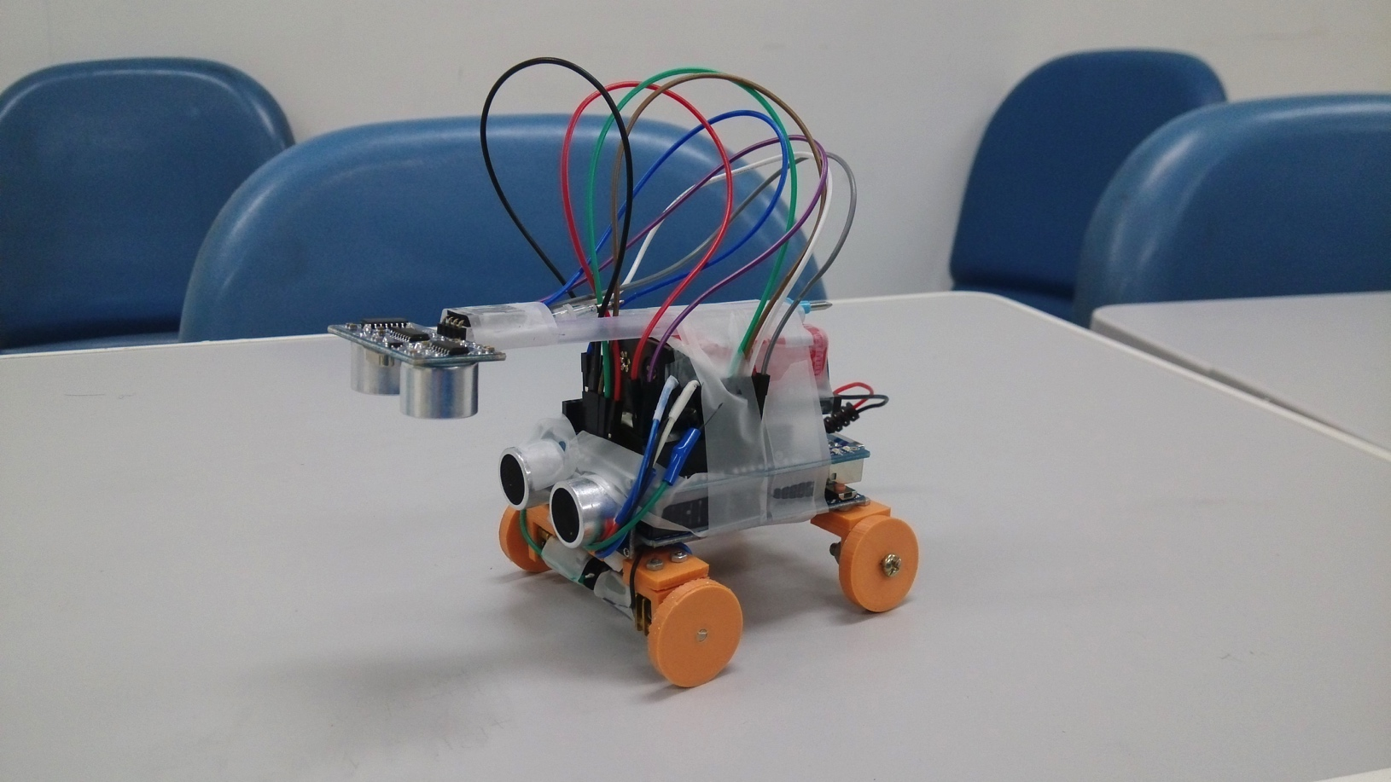
PART ONE------Arduino projects Auto obstacle avoiding car

Slide 4
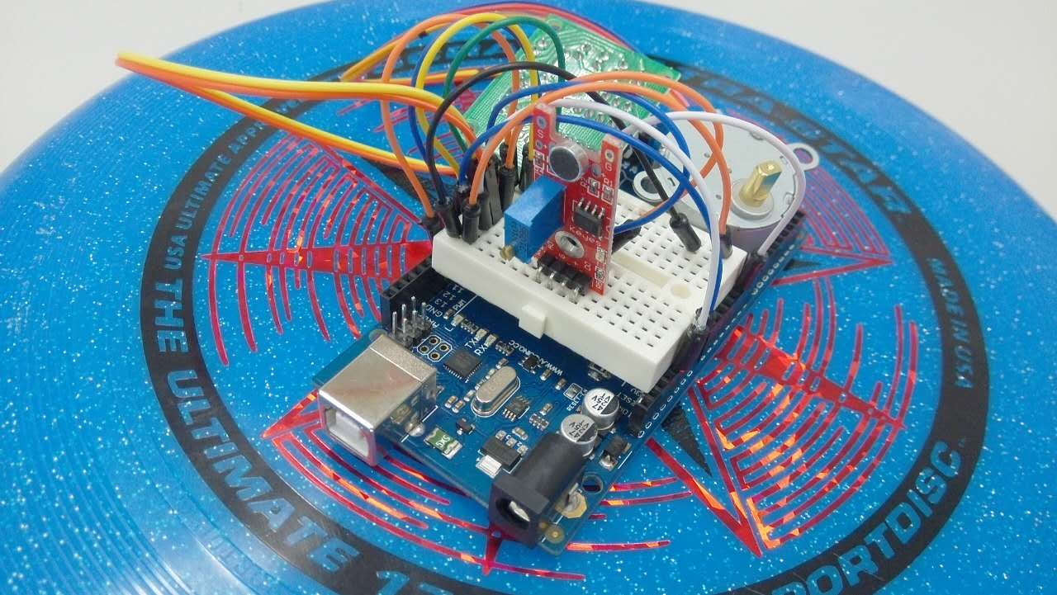
PART ONE------Arduino projects Auto snoring reminder

Slide 5
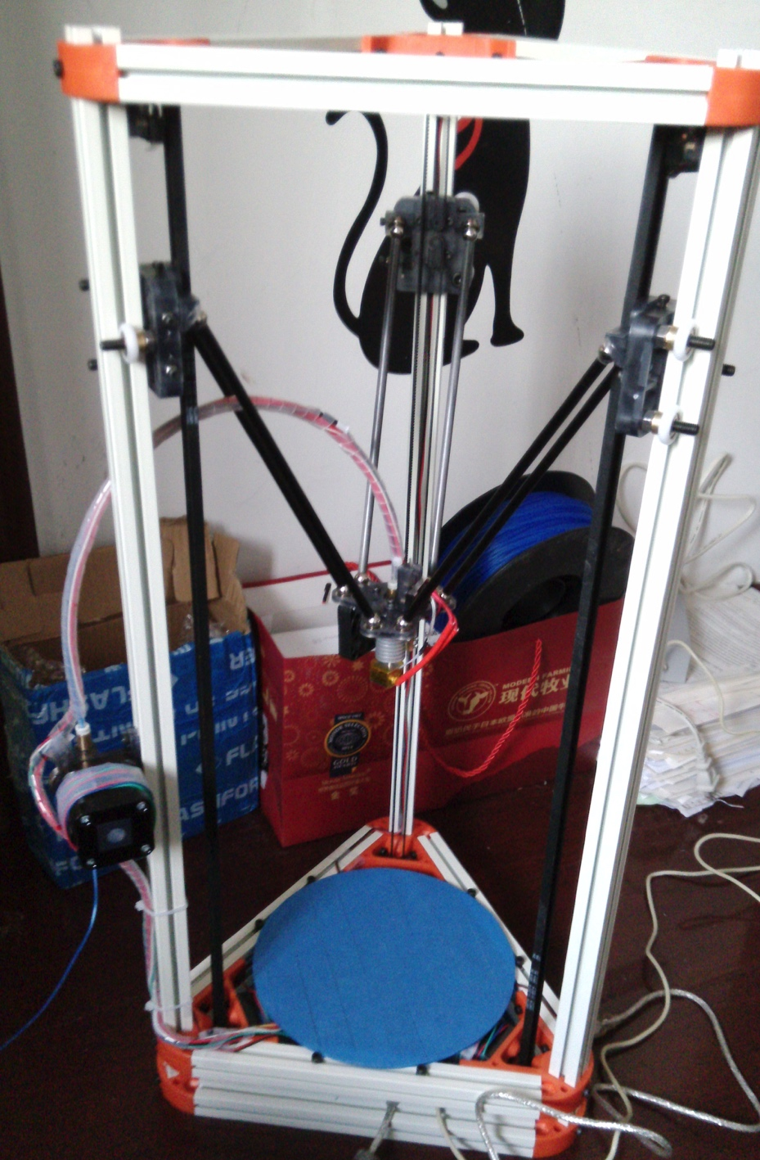
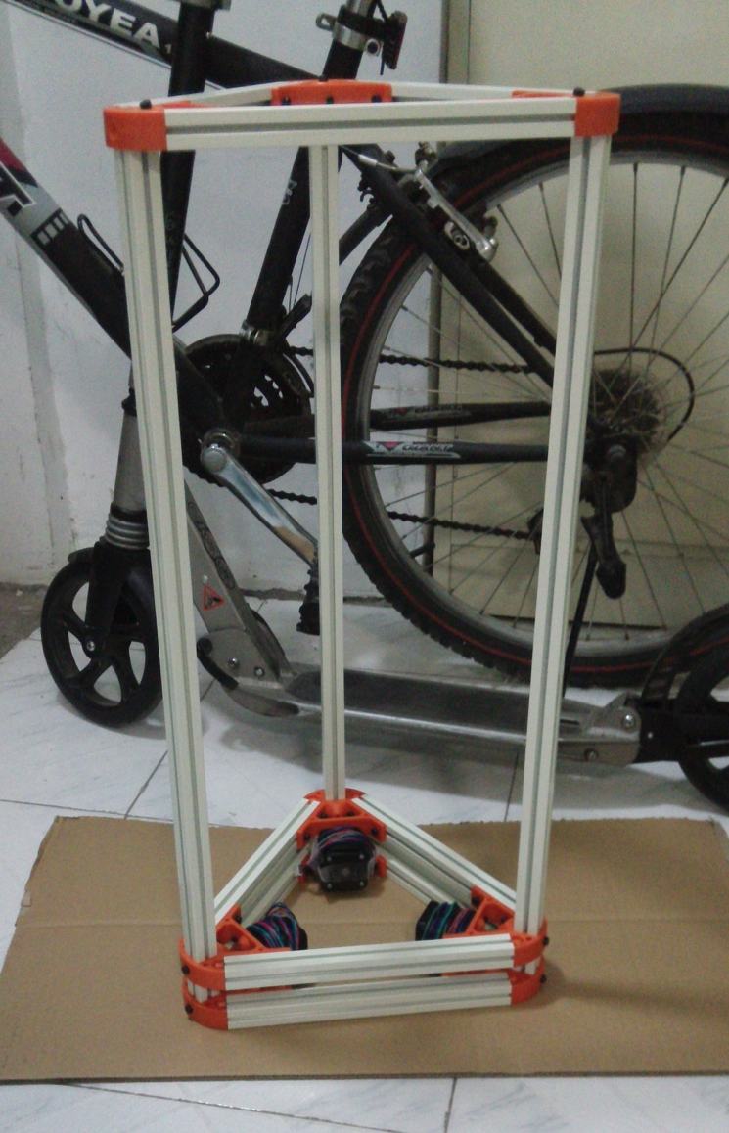
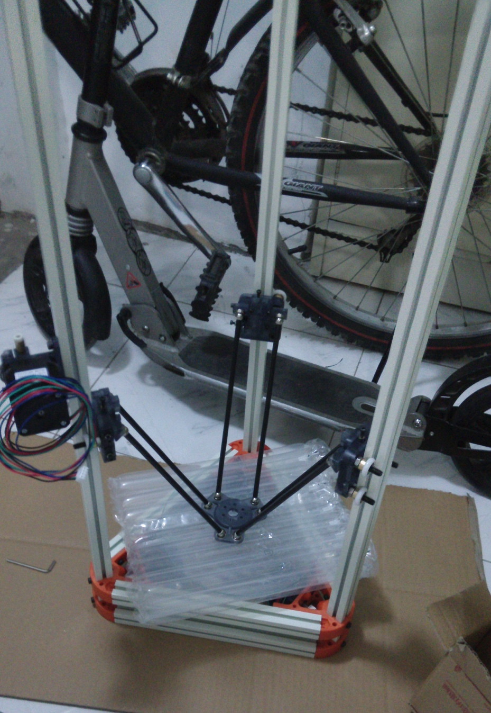
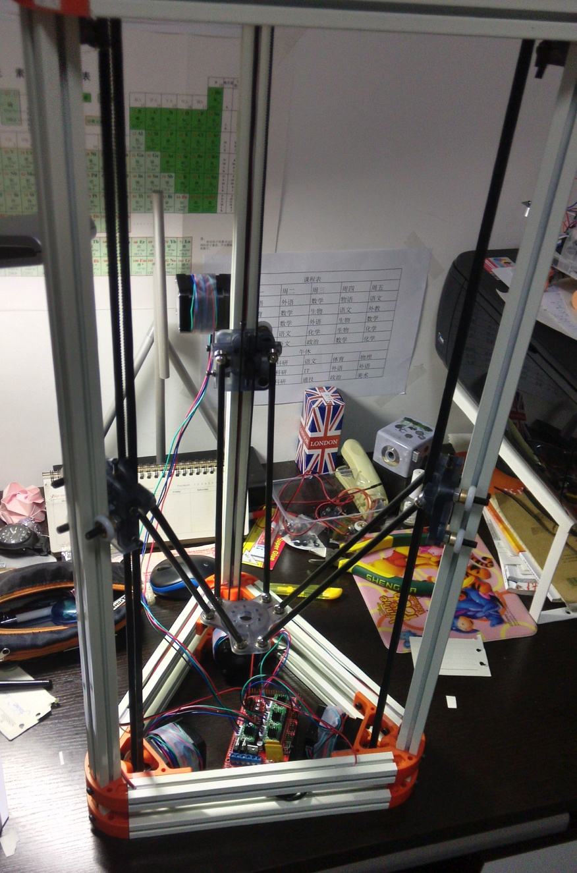
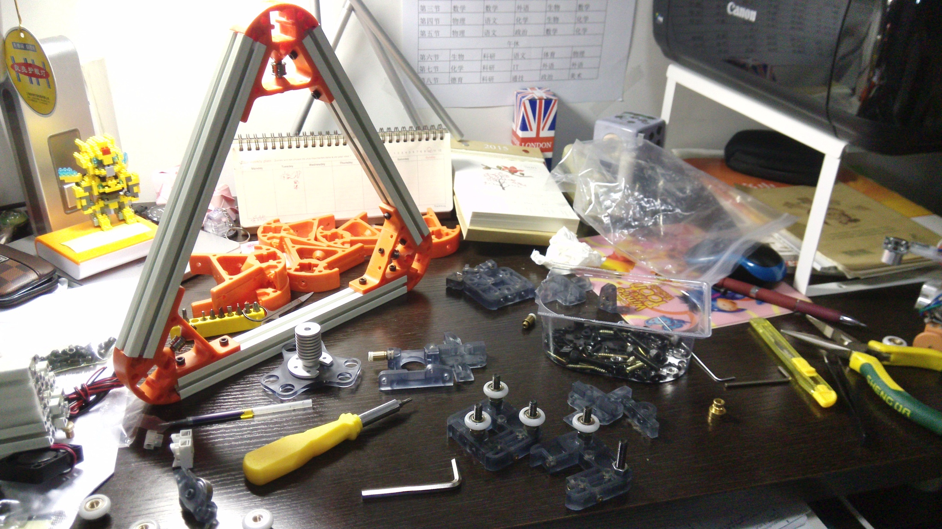
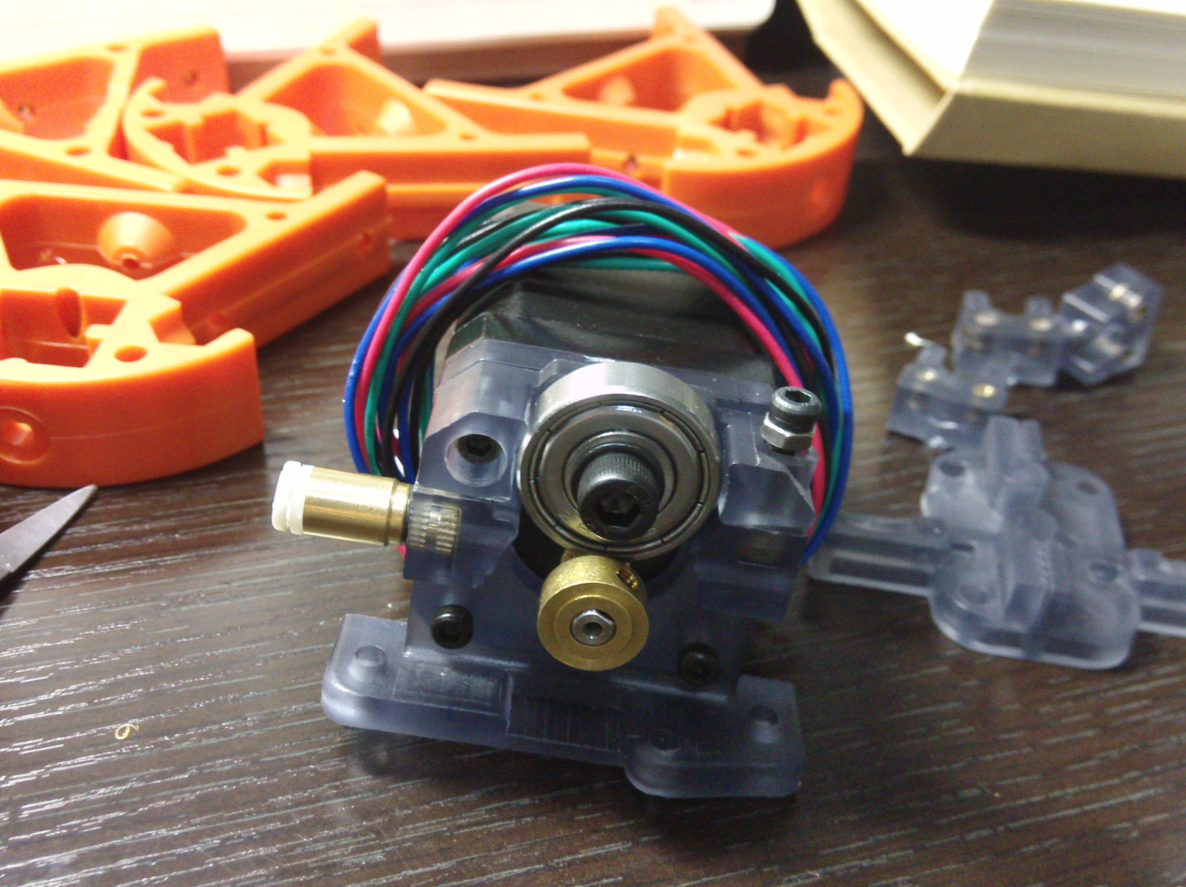
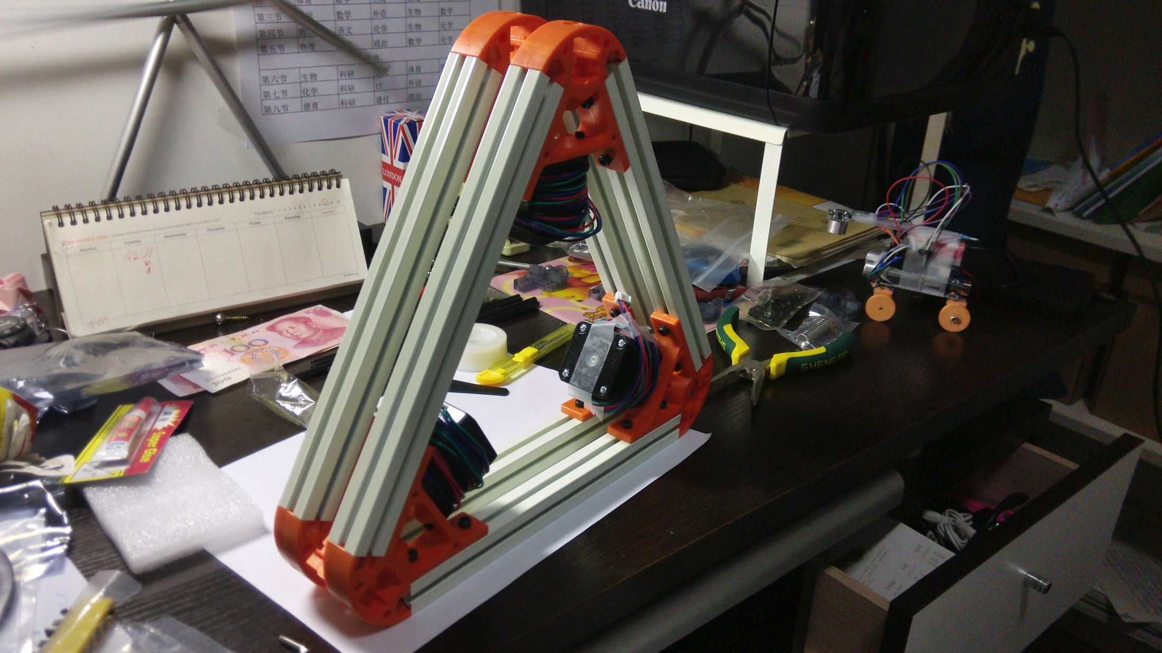
PART TWO------3D printing Buliding a 3D printer

Slide 6
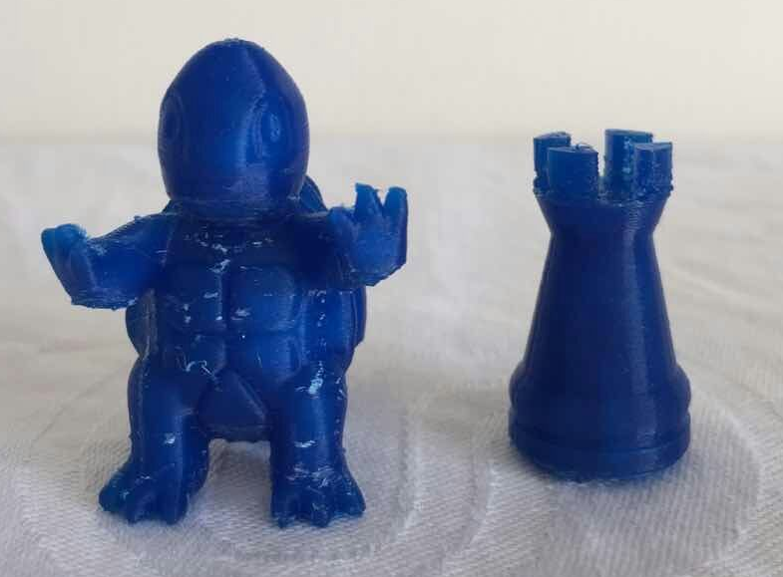
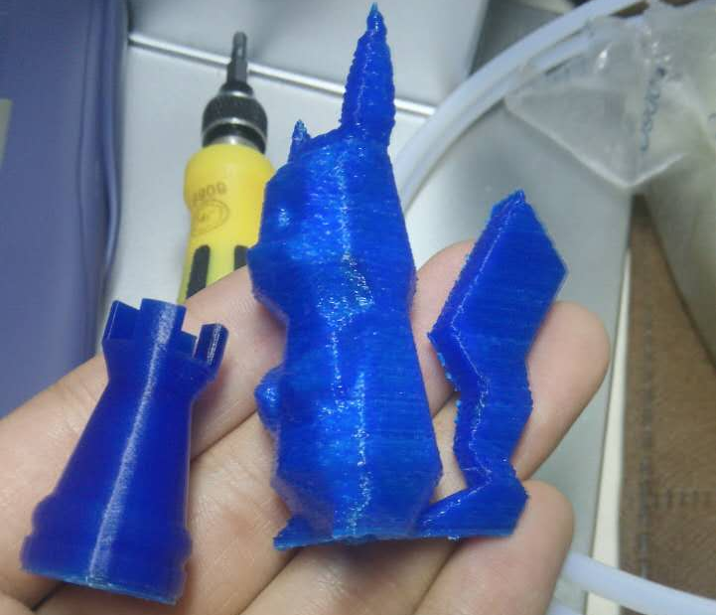
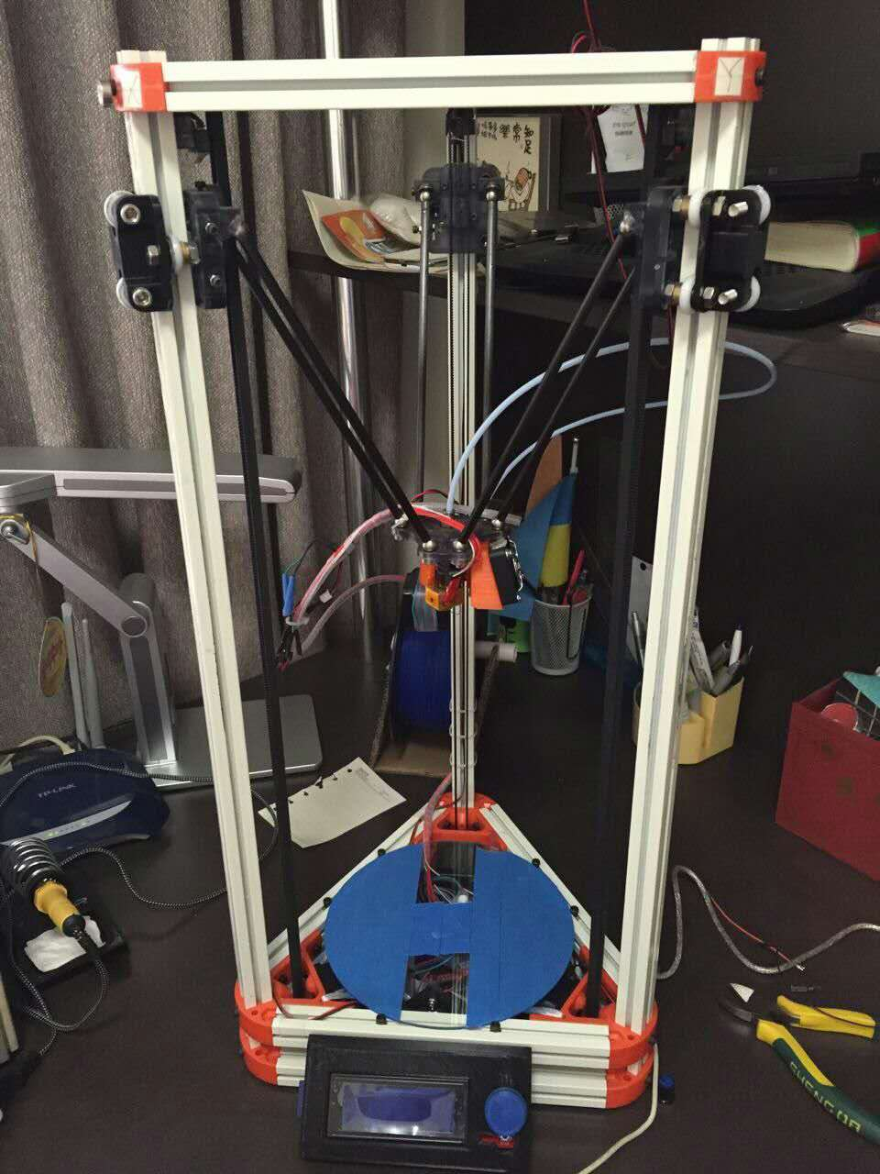
PART TWO------3D printing Buliding a 3D printer－final version

Slide 7
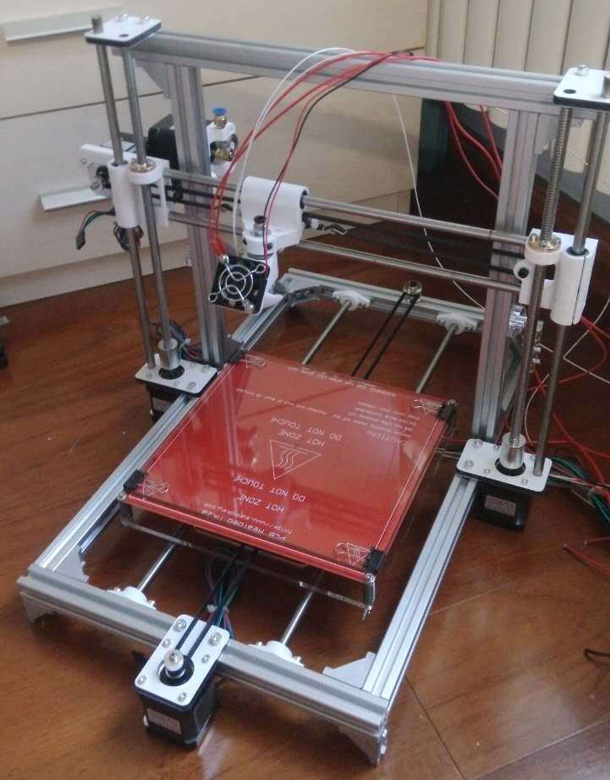
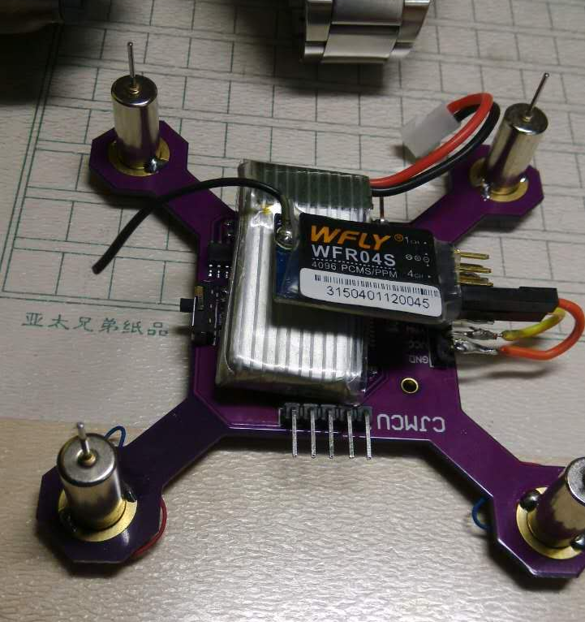
What’s more…… --future plans

Slide 8
Thanks!

